Slide 1
Amazon Web Services Certification Guide
2019
20 FEBRUARY 2019

Slide 2
Roadmap Summary
Identify the certification you intend to pursue
Ensure you meet pre-requisites
Prepare for your exam
Take a practice exam
Take the certification exam

Slide 3
Amazon Web Services Certification: Overview
Through the Accenture-Amazon Web Services Business Group (AABG), Accenture individuals have access to a wide range of Amazon Web Services (AWS) certification support materials.
This guide describes the following path to certification:
Identify the Certification you intend to pursue (slide 4)
Prepare for your exam (slide 6)
How to access AWS Preparation materials
How to obtain access to QWIKLabs Credits
How to obtain access to A Cloud Guru courses
How to obtain access to exam vouchers and service credits
Register for your exam (slide 11)
Pass your exam and register in myCertification (slide 20)
Key Contacts (slide 22)

Slide 4
Identify the Certification you intend to pursue

Slide 5
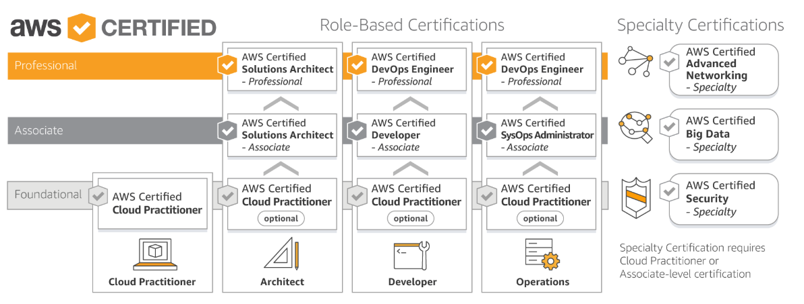
Amazon Web Services Certification Overview: Identify the type of certification you intend to pursue and review the Certification Overview below:
Certified Cloud Practitioner
(https://aws.amazon.com/certification/certified-cloud-practitioner/)
Certified Solution Architect-Associate (https://aws.amazon.com/certification/certified-solutions-architect-associate/)
Certified SysOps Administrator-Associate (https://aws.amazon.com/certification/certified-sysops-admin-associate/)
Certified Developer-Associate-(https://aws.amazon.com/certification/certified-developer-associate/)
AWS Certified Big Data – Specialty
(https://aws.amazon.com/certification/certified-developer-associate/)
AWS Certified Advanced Networking – Specialty
(https://aws.amazon.com/certification/certified-developer-associate/)
AWS Certified Security– Specialty
(https://aws.amazon.com/certification/certified-developer-associate/)
Certified Solution Architect-Professional (https://aws.amazon.com/certification/certified-solutions-architect-professional/)
Certified DevOps Engineer-Professional (https://aws.amazon.com/certification/certified-devops-engineer-professional/)
Certifications are valid for 2 years, at which time they must be renewed. If you need to get re-certified, follow the guidance at this link. (https://aws.amazon.com/certification/recertification/)

Slide 6
Prepare for your exam

Slide 7
How to Access AWS Preparation Materials
Amazon Web Services provides access to a number of free certification prep resources. You can access these at the following link:
https://aws.amazon.com/certification/certification-prep/
These resources include:
Exam Guides for each certification
Sample question set for each certification
AWS Whitepapers on specific topics (https://aws.amazon.com/whitepapers/)
AWS FAQs on specific services (https://aws.amazon.com/faqs/)

Slide 8
How to obtain access to QWIKLabs
QWIKLabs provide hands-on, real time exposure to key concepts. You can learn more about QWIKLabs at this link (https://qwiklabs.com/?locale=en)
QWIKLabs provides ‘Quests’ that guide you through labs designed to support specific certifications.
You may be able to obtain QWIKLabs credits when you are within 30 days of sitting for your exam.
To request access to QWIKLabs credits, submit the following information to jasmin.c.caballero@accenture.com
Enterprise ID
Type of Certification you are pursuing
Target date for obtaining certification
The enterprise ID or email of your training approver
Pre-requisite training you have completed
NOTE: You must access QWIKLabs using your Accenture ID to use the credits.

Slide 9
Access to A Cloud Guru certification preparation resources
Accenture has a licensing arrangement with A Cloud Guru (ACG) a 3rd party provider of exam preparation training.
You can register for the ACG platform in myLearning at this link: https://mylearning.accenture.com/myl-ui/learner/activityDetails?activityID=1515165&source=myLearning
NOTE: Individuals located in India and Phillipines should register using this link:
https://mylearning.accenture.com/Atlas/home.aspx?url=%23%2FactivityDetailsqmqmactivityID%3D1568589%26activitySource%3DLMS
Once your registration is approved, a tuition is charged that will enable you access to the complete A Cloud Guru course catalog and resources through May 2019.
NOTE: The tuition is charged to your team’s training WBS. If you are uncertain about the source of your training WBS, you should reach out to your training approver for more information.
Individuals wishing to access other 3rd party platforms such as Cloud Academy or Linux Academy should ‘Register for external training’ in myLearning.
Upon approval of the registration, individuals may be able to expense the license cost using the training WBS provided upon authorization.

Slide 10
How to access Exam Vouchers
Exam vouchers take several forms:
For Cloud Practitioner and Specialty exams, AABG provides final exam vouchers only
For Associate and Professional exams, AABG provides practice and final exam vouchers.
For recertifications, AABG may provide recertification exam vouchers.
Pre-requisite(s)
For Cloud Practitioner exams, you must have completed the AWS Cloud Practitioner Essentials self study course. Submit a copy of your completion certificate when requesting vouchers.
For associate certification vouchers, you must first have attended a relevant training course in the prior 18 months (currently this includes Architecting for AWS, Developing on AWS, Big Data on AWS or SysOps Administration on AWS). In some cases, exception can be made for significant hands on experience or formal training completed through approved 3rd party platforms.
If you are pursuing Professional or Specialty Certification, you must have already received an associate level certification.
If you meet the pre-requisite(s), then the process for obtaining vouchers is as follows:
When you are within 30 days of taking the final exam, send the following information to Jasmin Caballero (jasmin.c.caballero@accenture.com) with cc to: Jeff Hammond Jeffrey.s.s.Hammond@accenture.com
Enterprise ID
Your Training Approver
The date by which you intend to complete certification
The type of certification you intend to pursue
Confirmation of the pre-requisite training and date you attended
If you are pursuing Professional or Specialty Certification Exam vouchers, submit the associate certification you possess and date obtained
You will receive a practice exam voucher, which you must use within 10 days.
Take and pass your practice exam
Send confirmation of passing your practice exam to Jasmin Caballero (jasmin.c.caballero@accenture.com) with cc to: Jeff Hammond Jeffrey.s.s.Hammond@accenture.com
You will then receive a voucher for the relevant exam that you are taking, which you must use within 30 days.
Schedule your exam using the voucher
If you are unable to take the exam as scheduled, please reach out to Jasmin Caballero (jasmin.c.caballero@accenture.com) with cc to: Jeff Hammond Jeffrey.s.s.Hammond@accenture.com

Slide 11
Register for your Certification Exam

Slide 12
Amazon Web Services Certification Step 1: Register for Certification in myLearning if you intend to expense the cost. If you have a voucher go to next step
You should reach out to obtain an exam voucher prior to scheduling your practice or final exams per instructions on slide 10.
If you are unable to obtain an exam voucher per slide 10, you may be able to expense the cost of the voucher using these steps. You should alwaya obtain approval for your registration prior to incurring any expense.
For reimbursement of expense and time, please use the links below to register for the respective certification in myLearning. Complete the Vendor Training Request (VTR) form that opens up. In the charge code field, enter your DTE-specific, 8-digit WBSE number. For a missing training DTE-specific WBS Element value in myLearning reach out to your local HR resource.
AWS Certified Cloud Practitioner
AWS Certified Solutions Architect - Associate Level
AWS Certified Developer - Associate Level
AWS Certified SysOps Administrator - Associate Level
AWS Certified Solutions Architect or DevOps - Professional Level
AWS Certified Advanced Networking - Specialty
AWS Certified Big Data – Specialty
AWS Certified Security –Specialty
Charging Training Time & Claiming Certification Expenses in myTE Application
myTimeandExpenses has a system change that only allows you to submit Central Training Course Time and Expense charges against the “Central Training – Participant” Static Project number. Select the relevant “Central Training – Participant” Static Project numbers from the myTE Assignments drop down view
NOTE: The name of this Assignment may vary depending on the country you are based in. For assistance, please contact your Local TE Functional Support.

Slide 13
Amazon Web Services Certification Step 2: Go to the AWS Certification Page
Go to the certifications page at: http://aws.amazon.com/certification/

Slide 14
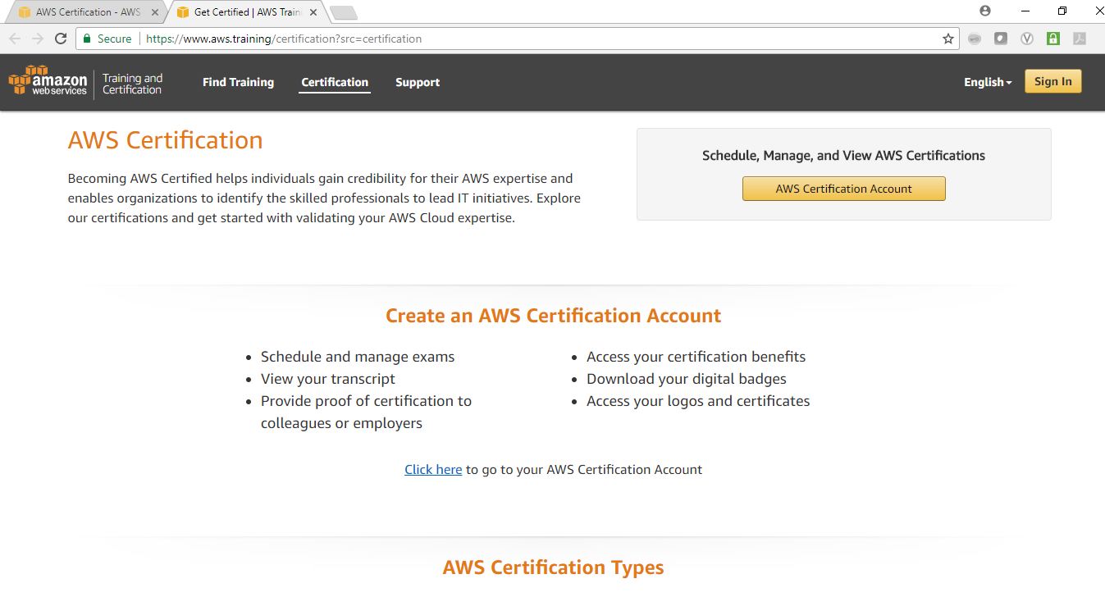
Amazon Web Services Certification Step 3a: Login to the AWS Certification Website
Click the AWS Certification Account box

Slide 15
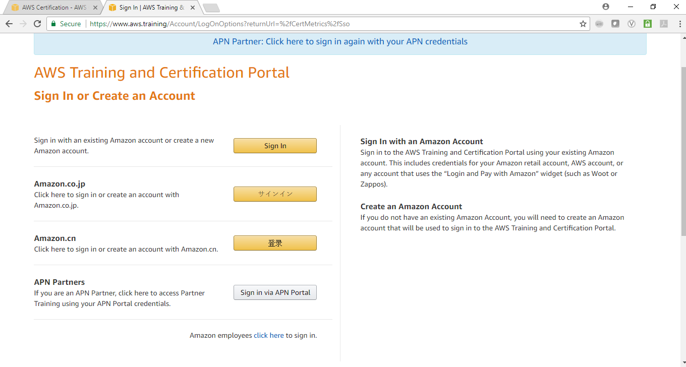
Amazon Web Services Certification Step 3b: Sign in or Create a New Account at AWS
:
1) If you have a partner portal account, you should sign in by clicking ‘Sign in via APN Portal’.
2) If you do not have a partner portal account, you should create one and use those credentials to log in to the certification site.
To create a partner portal account, click ‘Sign in via APN Portal’ button, select ‘Create New Account’ and follow the instructions. If you are unable to create a partner portal account, you may be able to use an existing AWS retail account to sign in.

Slide 16
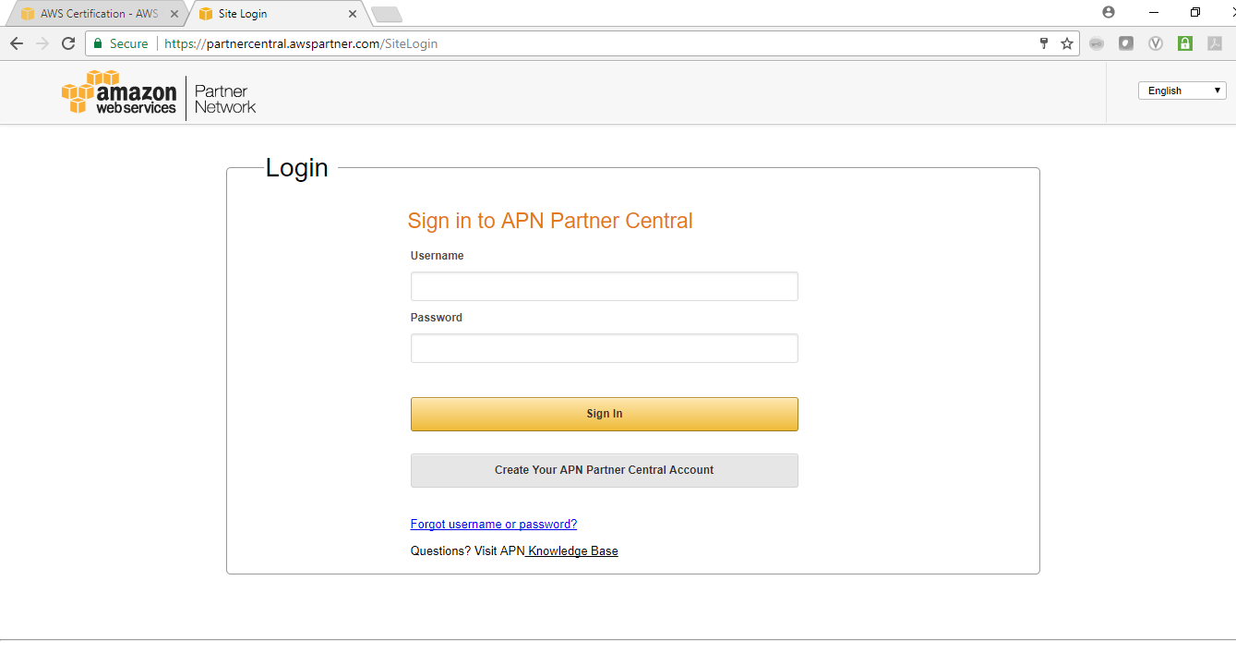
Amazon Web Services Certification Step 3c: Sign in via Partner Portal
.
Enter your Partner Portal account credentials and click sign in

Slide 17
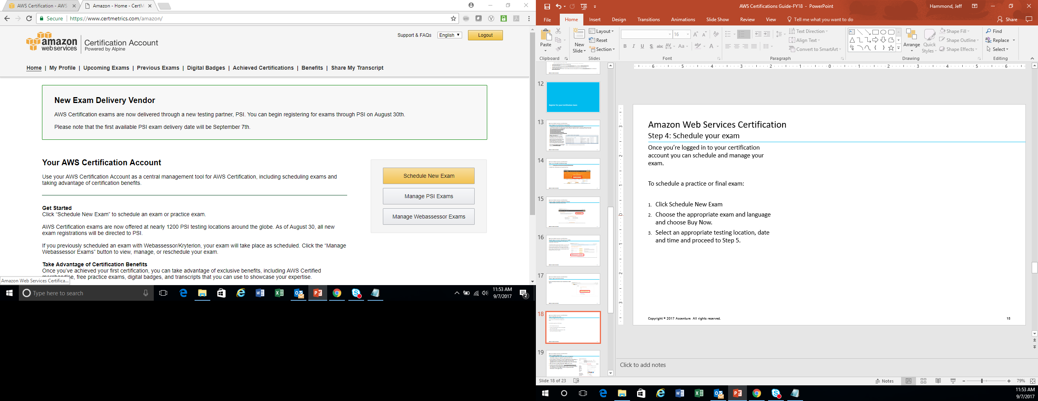
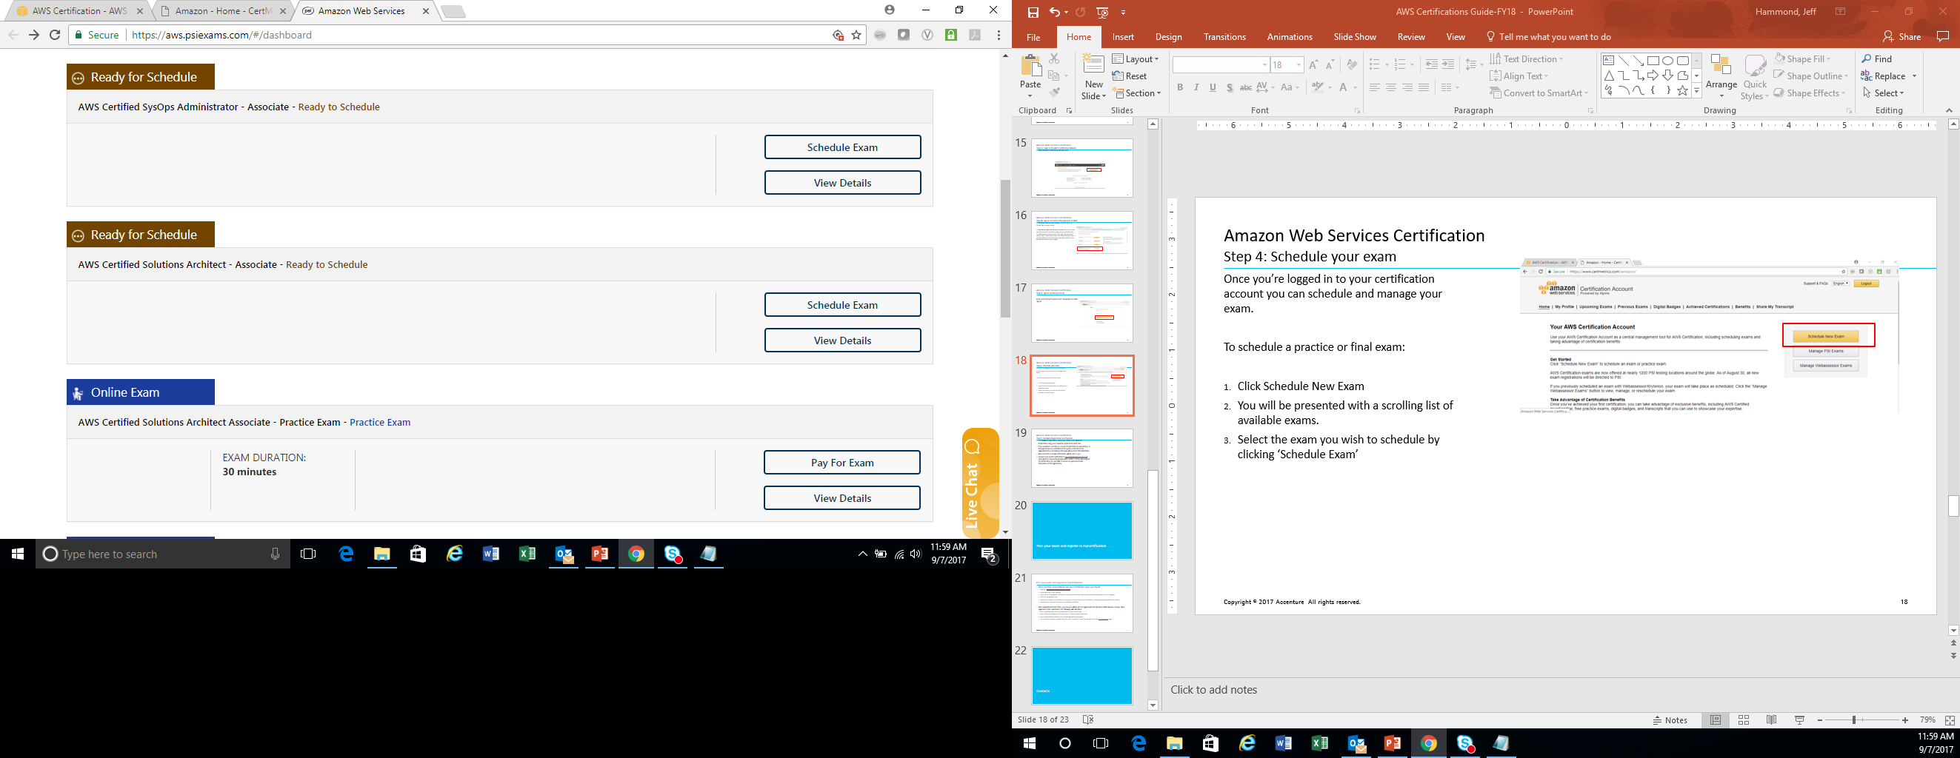
Amazon Web Services Certification Step 4: Schedule your exam
Once you’re logged in to your certification account you can schedule and manage your exam.
To schedule a practice or final exam:
Click Schedule New Exam
You will be presented with a scrolling list of available exams.
Select the exam you wish to schedule by clicking ‘Schedule Exam’

Slide 18
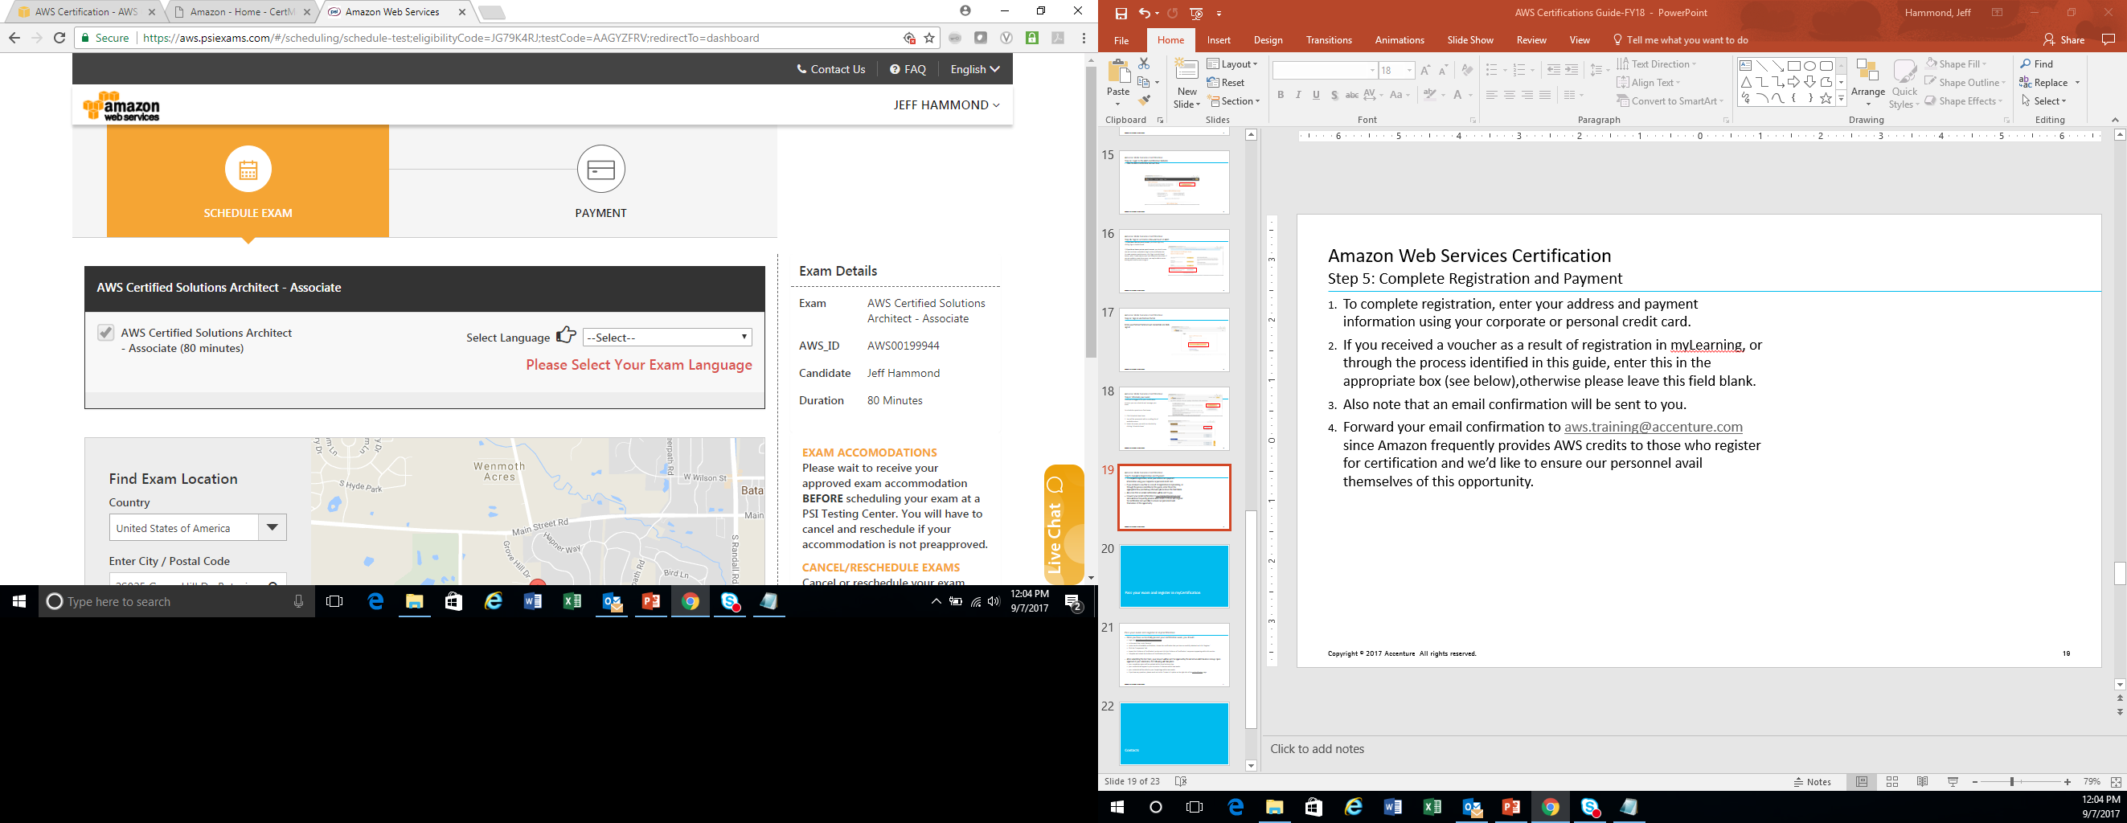
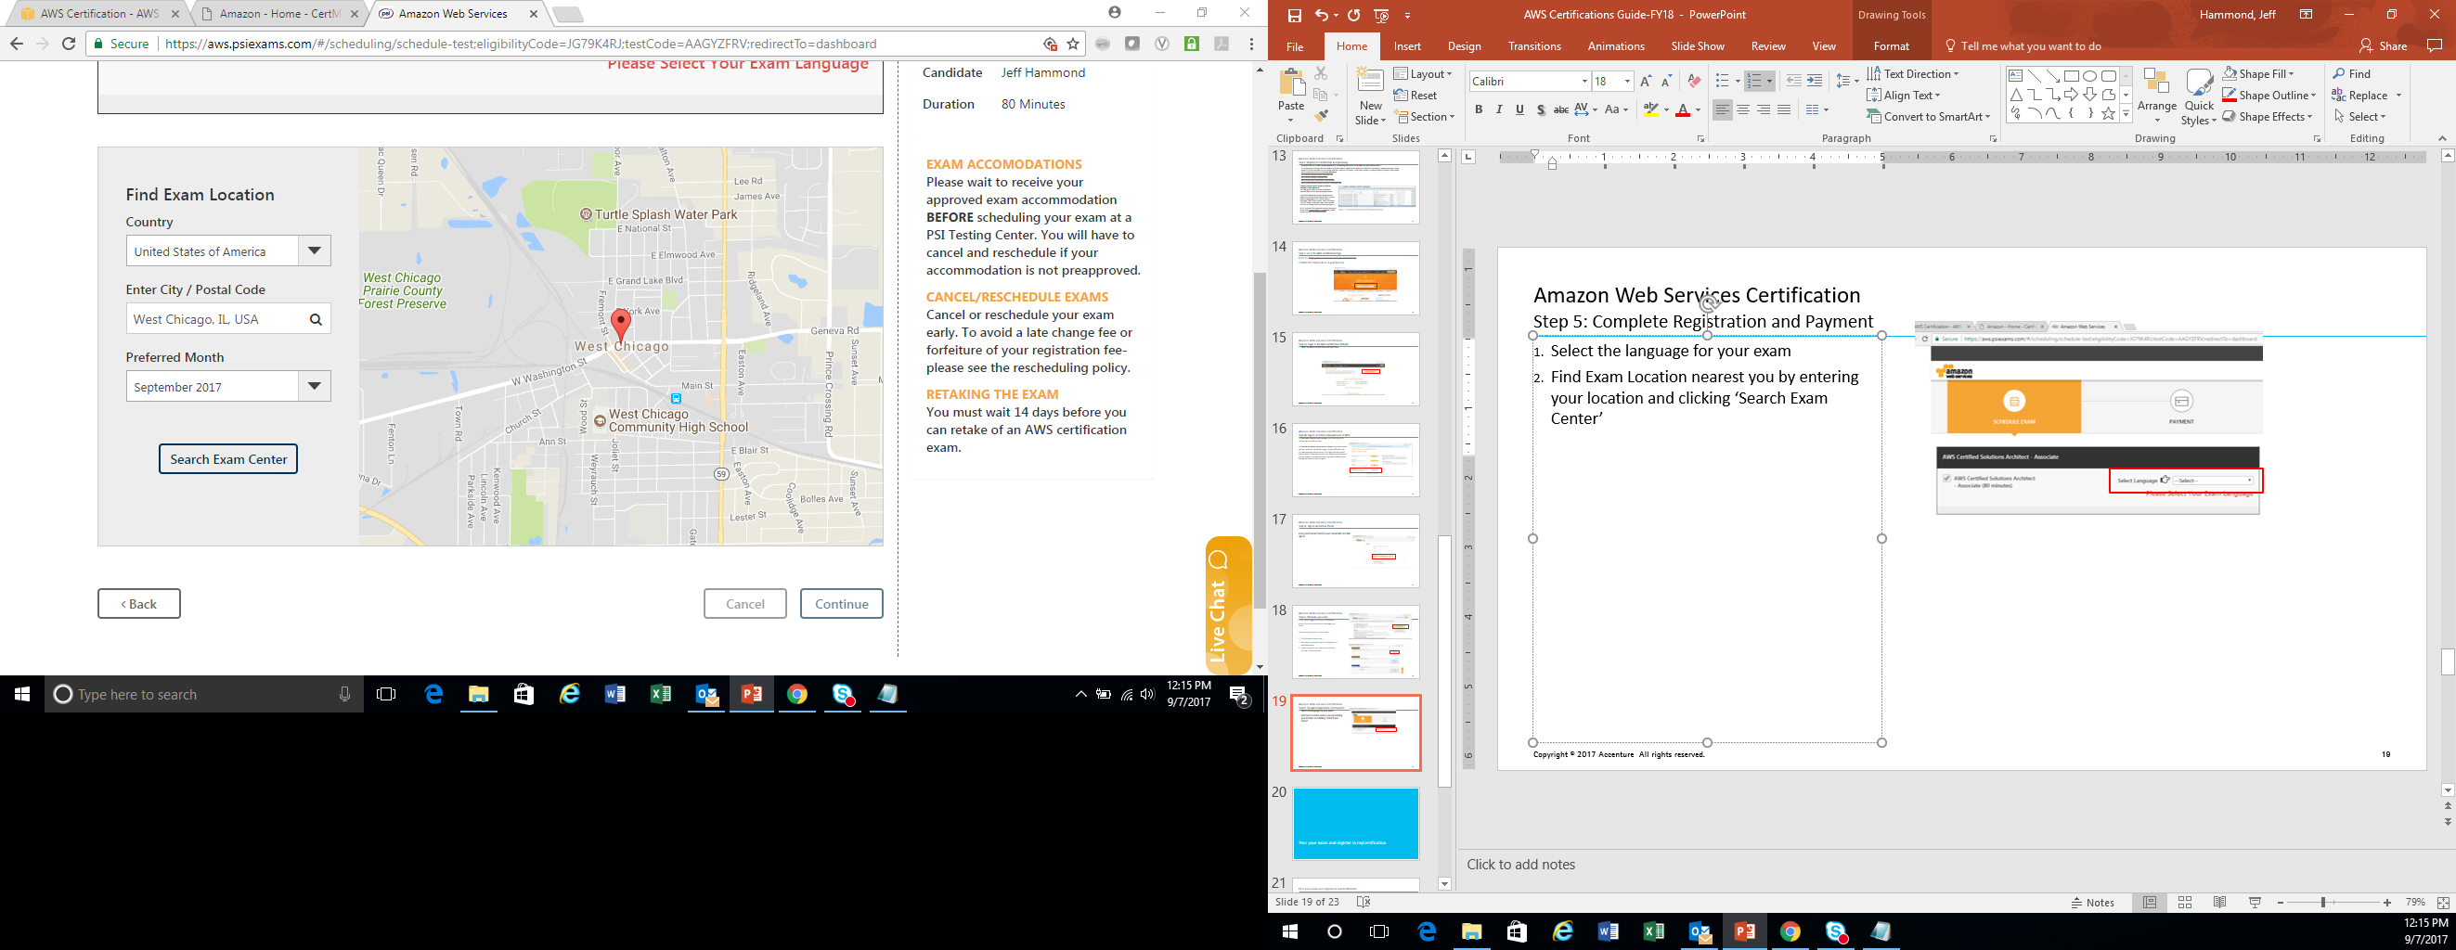
Amazon Web Services Certification Step 5: Complete Registration
Select the language for your exam
Find Exam Location nearest you by entering your location and clicking ‘Search Exam Center’ (see note below for practice exams)
Review the exam centers near you and select from available exam dates and times.
Click continue, then schedule exam.
NOTE: For practice exams, you will move to the payment screen after selecting your language. Because the practice exam is taken online, no exam location must be selected.

Slide 19
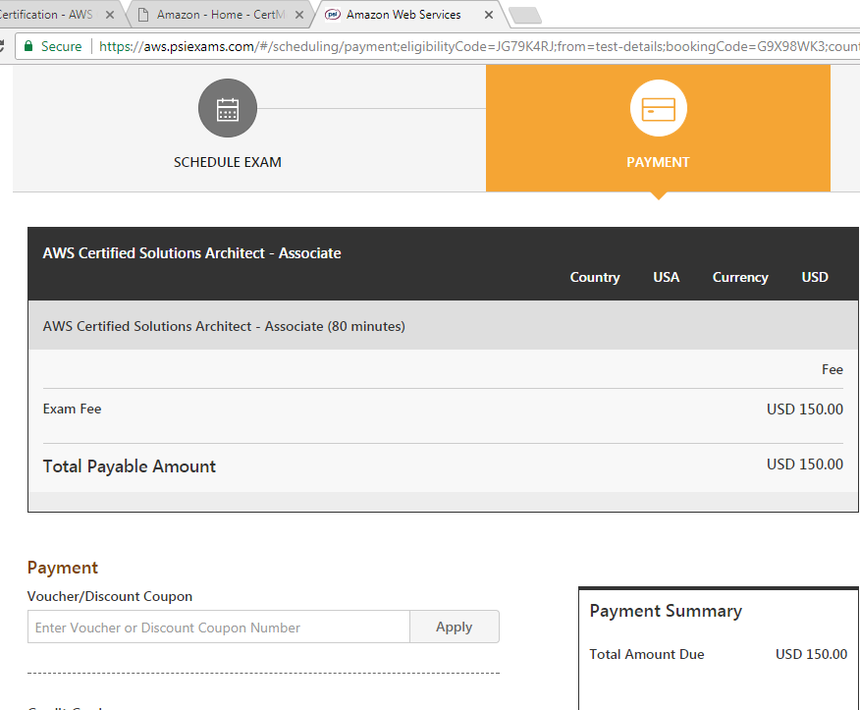
Amazon Web Services Certification Step 6: Complete Payment
To pay for your exam, you can enter the Voucher/Discount Coupon in the field highlighted
Click Pay Now and your exam confirmation should appear.

Slide 20
Pass your exam and register in myCertification

Slide 21
Pass your exam and register in myCertification
Once you have successfully passed your certification exam, you should:
Login into https://mycertification.accenture.com
In the search box, enter ‘Amazon’
Under the list of available certifications, choose the certification that you have successfully obtained and click ‘Register’
Click the ‘Components’ tab
Expand the ‘Evidence of Certification’ section and click the ‘Evidence of Certification’ component appearing within this section
Complete and submit the Evidence of Certification (EoC) form. Please note that your AWS Validation Number should be entered in the ‘AWS certification number’ field.
After submitting the EoC form, your request will be sent for approval by the Accenture-AWS Business Group. Upon approval of your submission, the following will take place:
your completion status will be updated within three business days.
your credential will appear in your Accenture CV-Resume within two weeks.
your credential will be added to your People Page within two weeks.
If you have any questions, please reach out to the ‘Contact Us’ option on the right side of the myCertification page.

Slide 22
Contacts

Slide 23
Amazon Web Services Certification
If you have any questions or concerns you may contact any of the following:
AWS.Training, AWS Training Shared Mailbox
Certification Exam Vouchers/Service Credits
jasmin.c.caballero@accenture.com
QWIKLabs Credits
jasmin.c.caballero@accenture.com
A Cloud Guru
jasmin.c.caballero@accenture.com
Jeff Hammond, AABG, Global Capability Enablement Lead
Pinkie Mpetwane, Learning & Talent Development Lead (Cloud)

